Slide 1


Tableau Project- ‘Bank Loan Risk Analysis Dashboard’ Presented By ‘Nutan Zine’

Slide 2
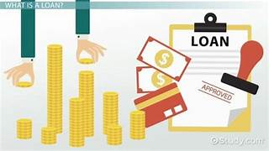
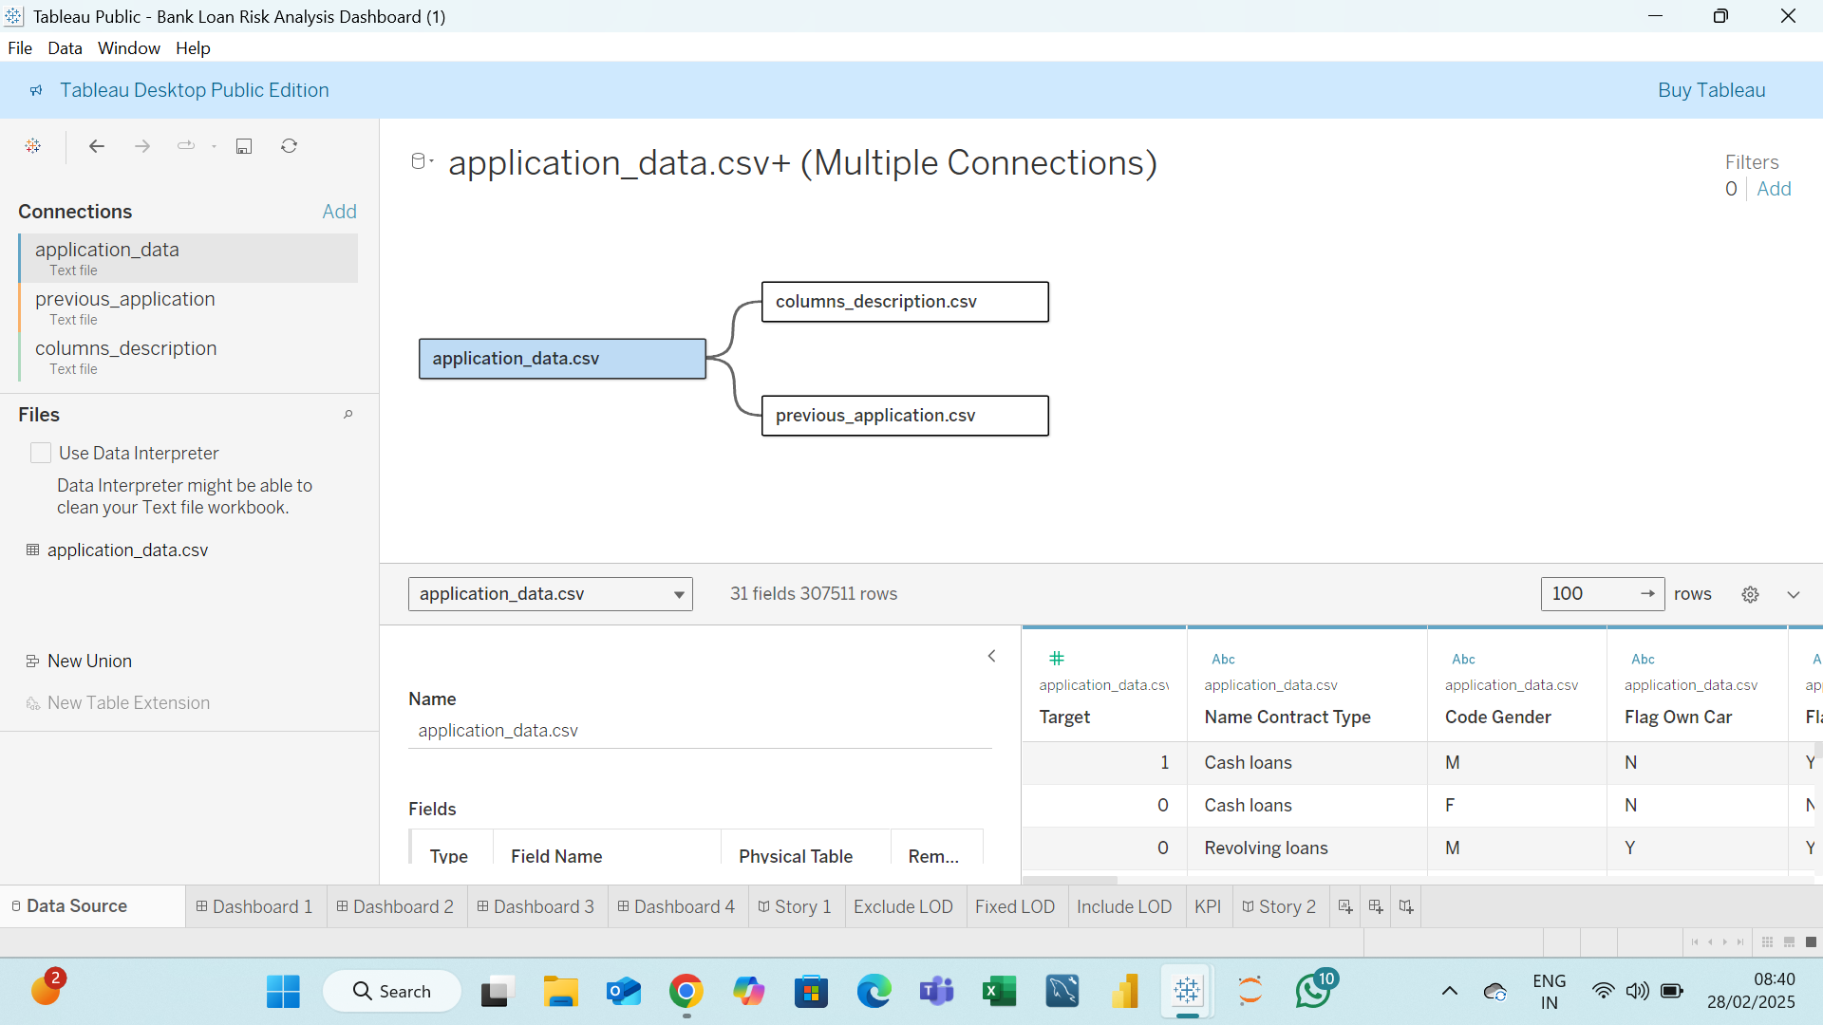
Here I’ve take 3 .csv i.e. Text Files & add these files & Below is the Metadata Of the files.

Slide 3

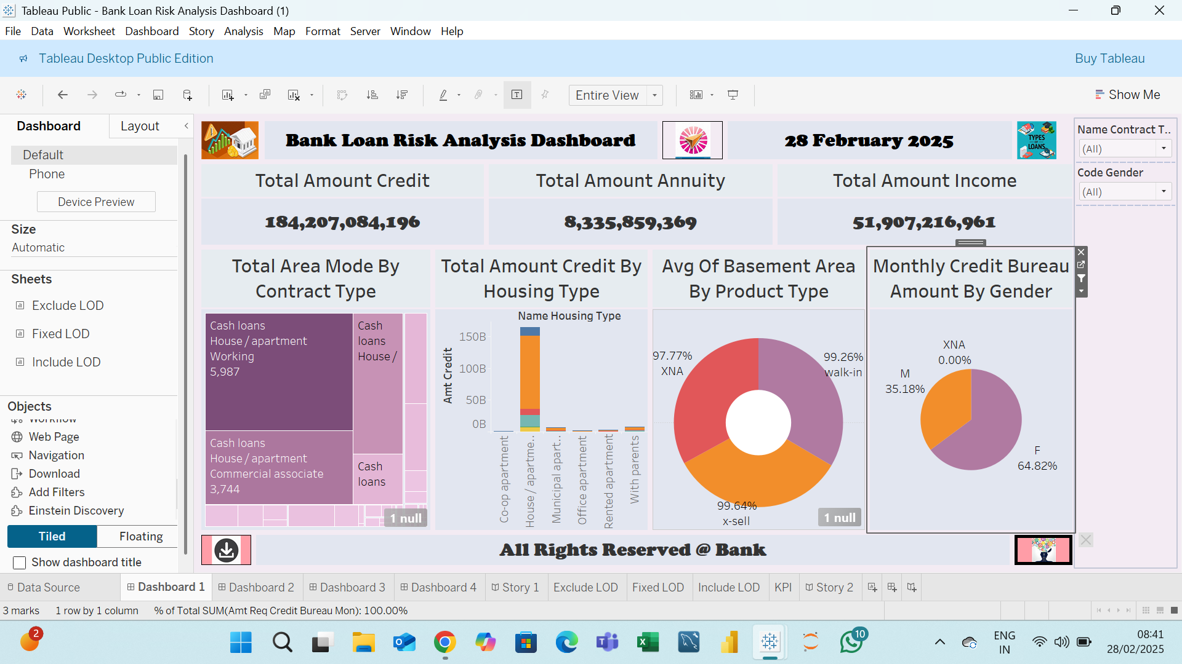
This is my First Dashboard

Slide 4

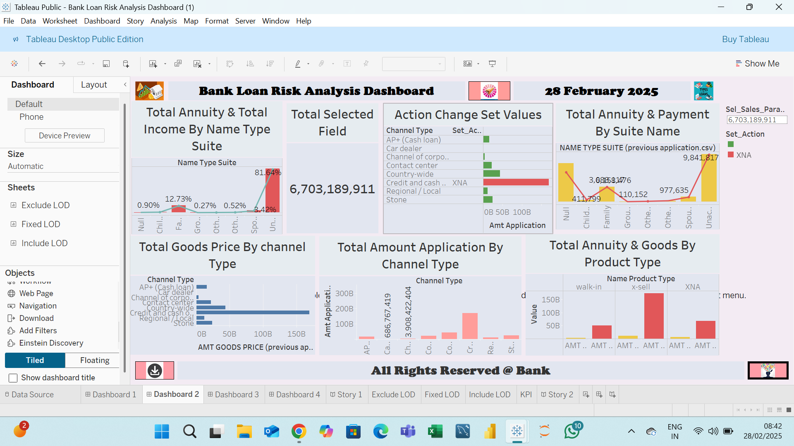
This is my Second Dashboard

Slide 5

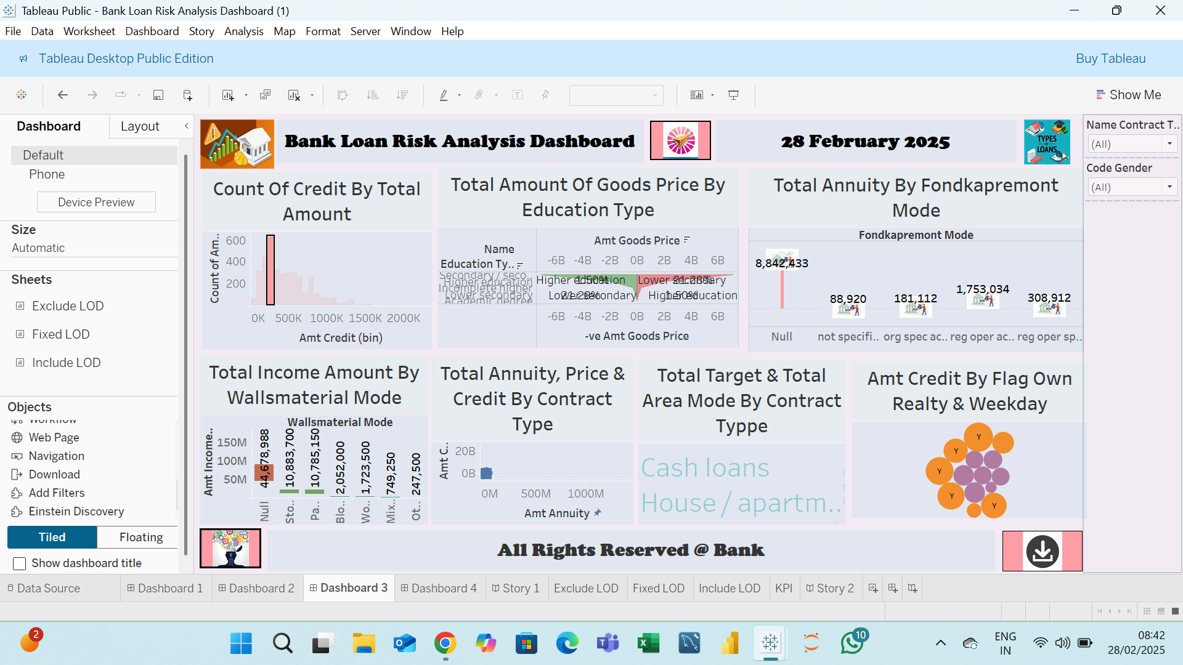
This is my Third Dashboard

Slide 6

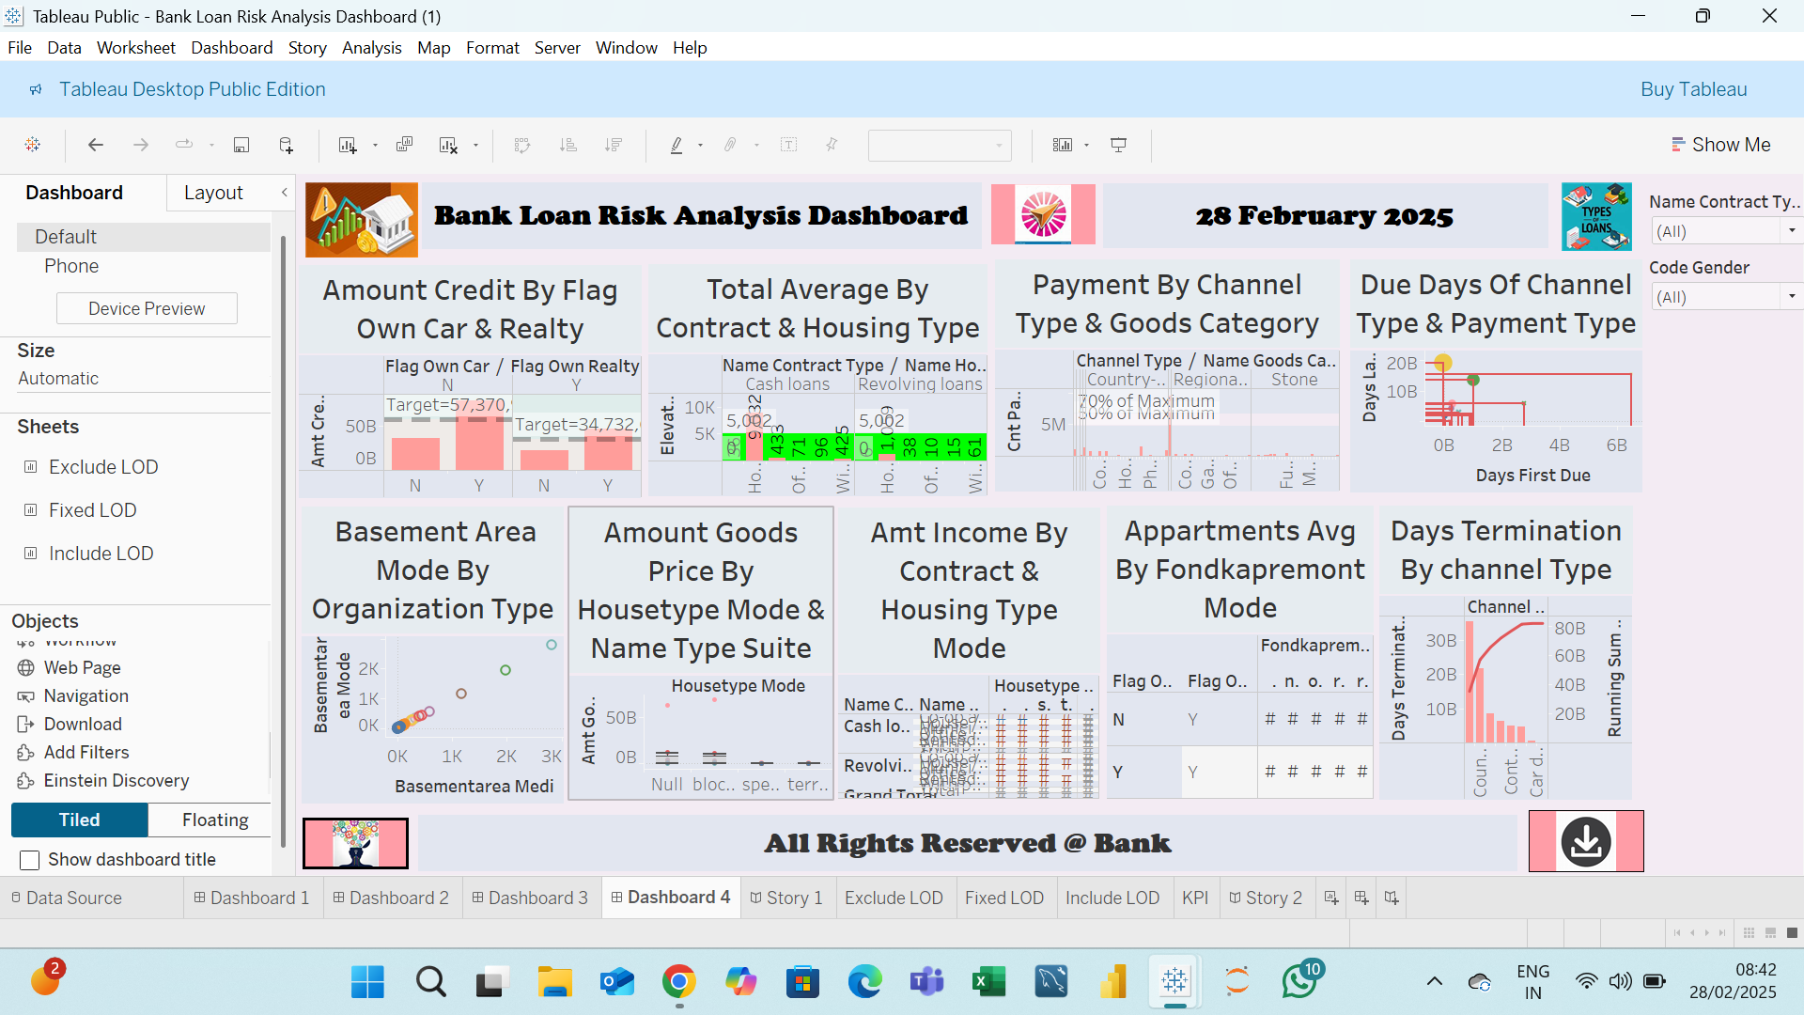
This is my Fourth Dashboard

Slide 7

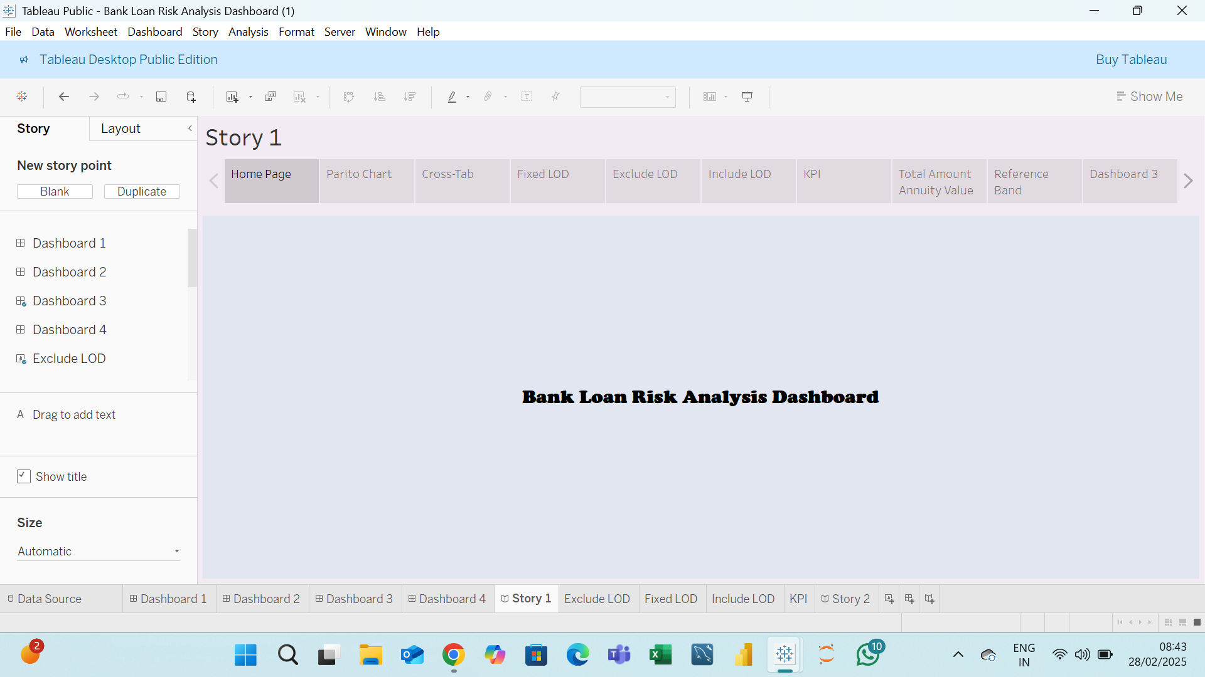
Home Page Of Story 1

Slide 8

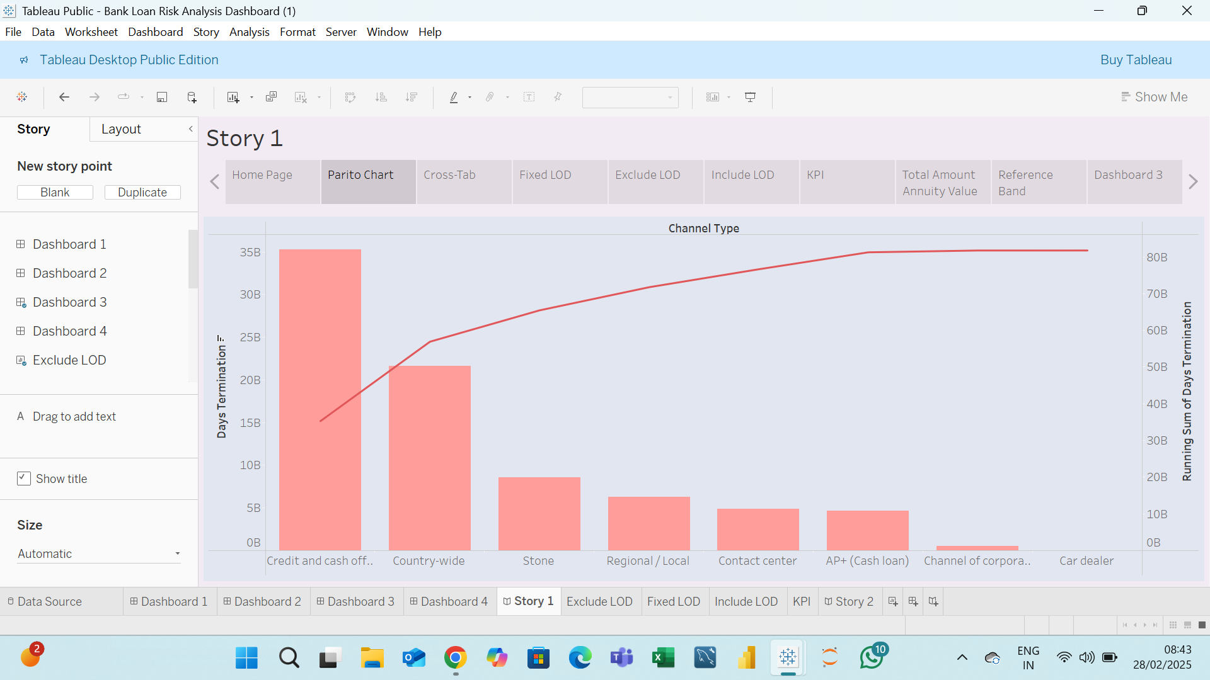
Pareto Chart Of Story 1

Slide 9

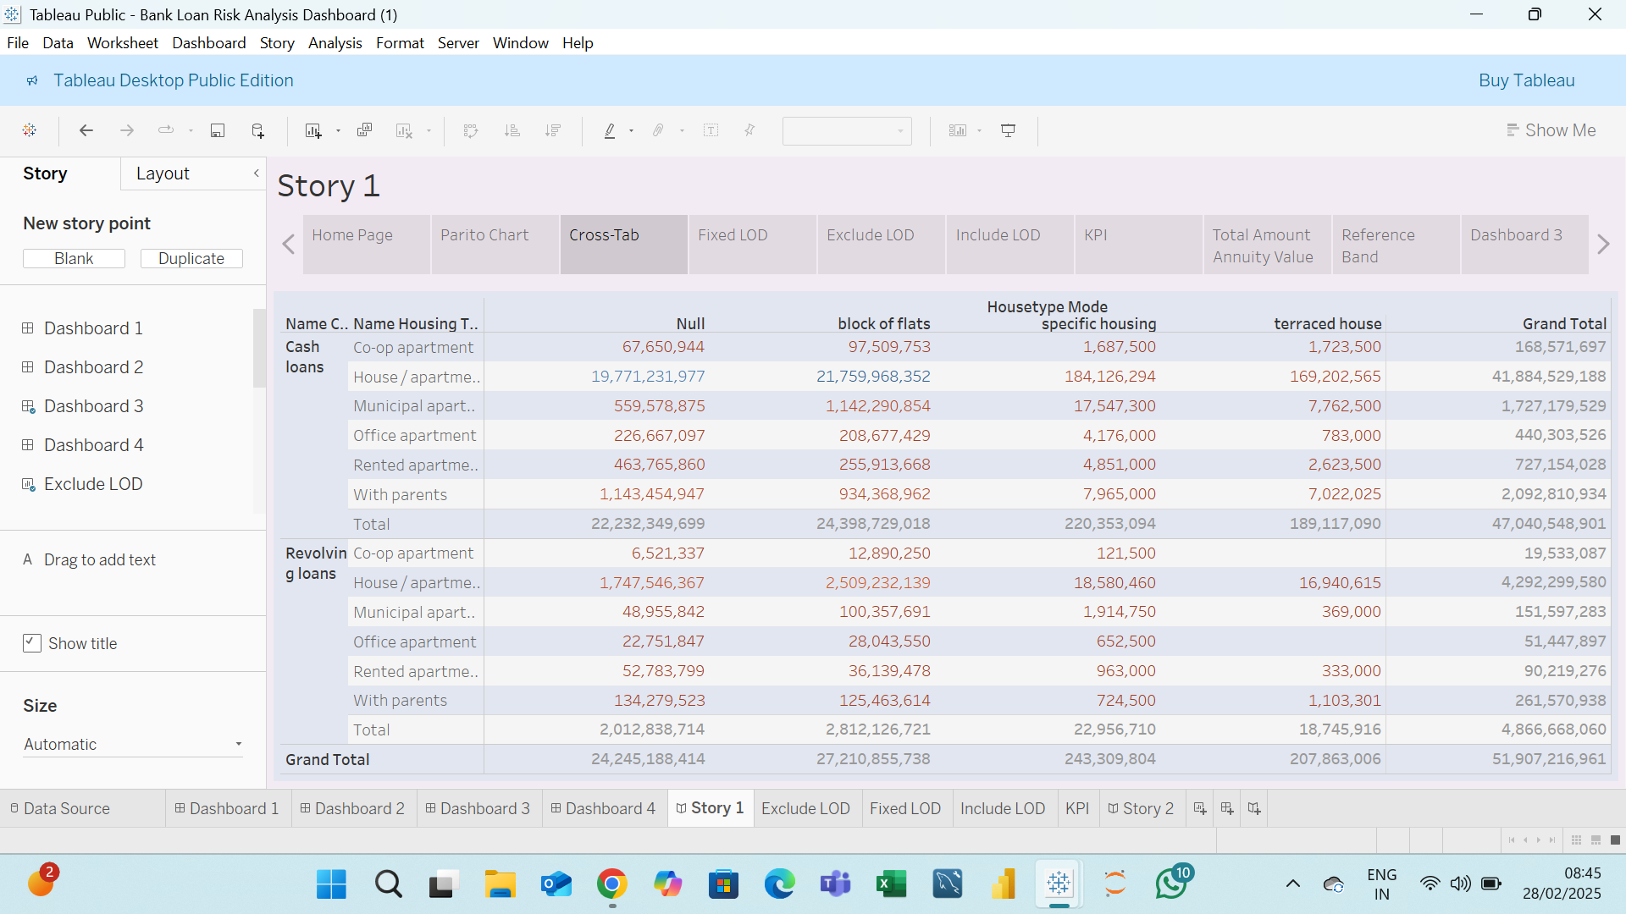
Cross – Tab Of Story 1

Slide 10

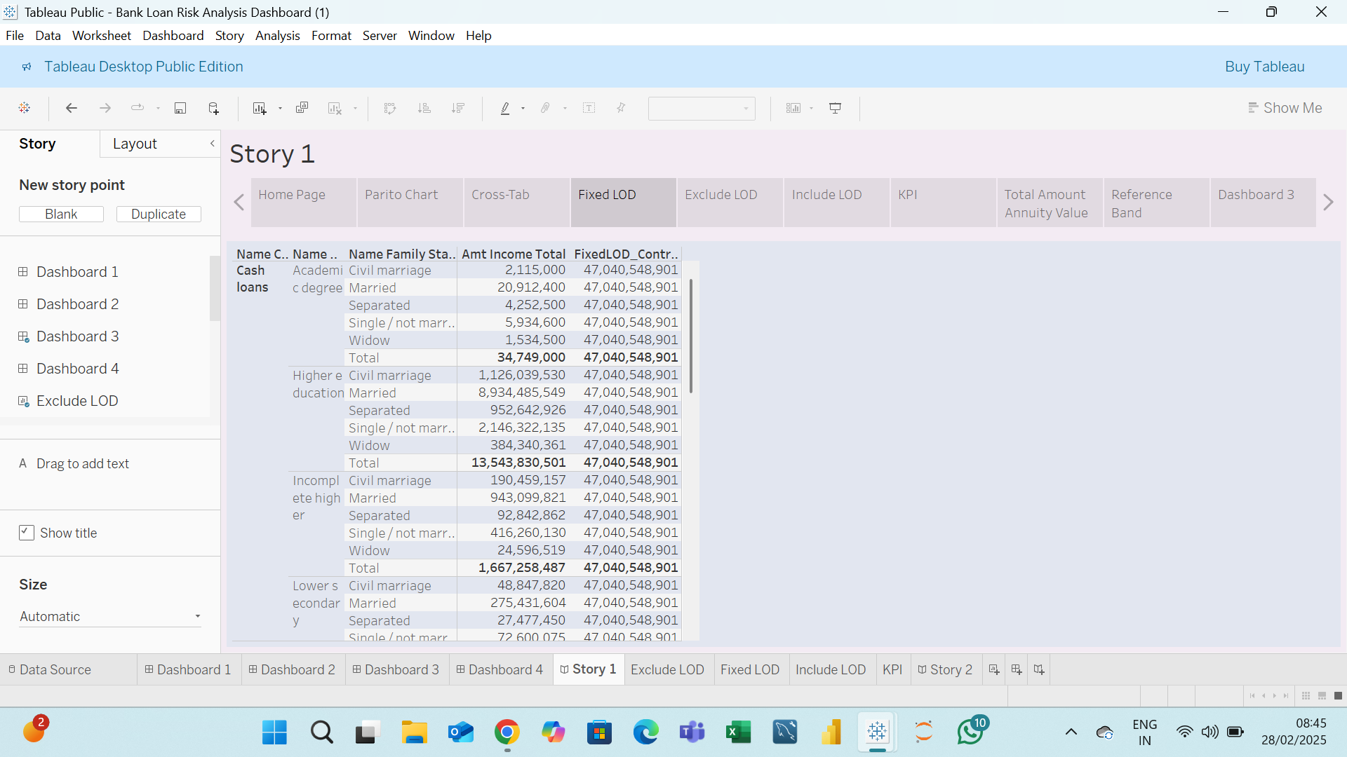
Fixed LOD Of Story 1

Slide 11

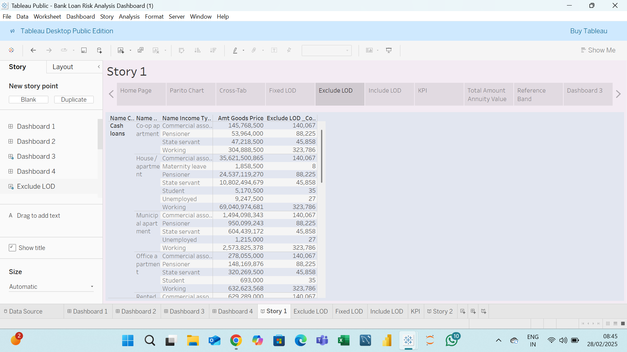
Exclude LOD Of Story 1

Slide 12

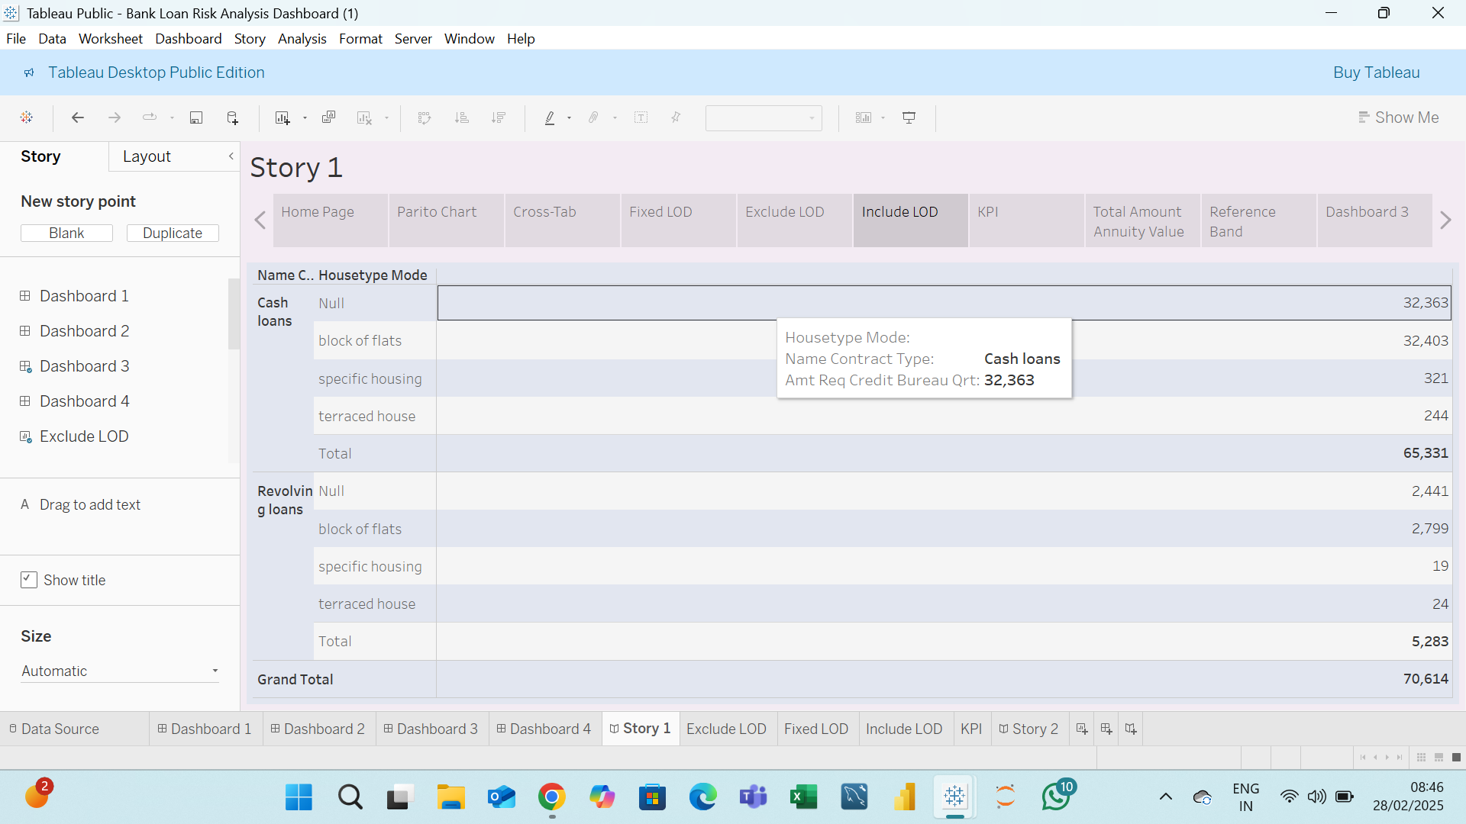
Include LOD Of Story 1

Slide 13

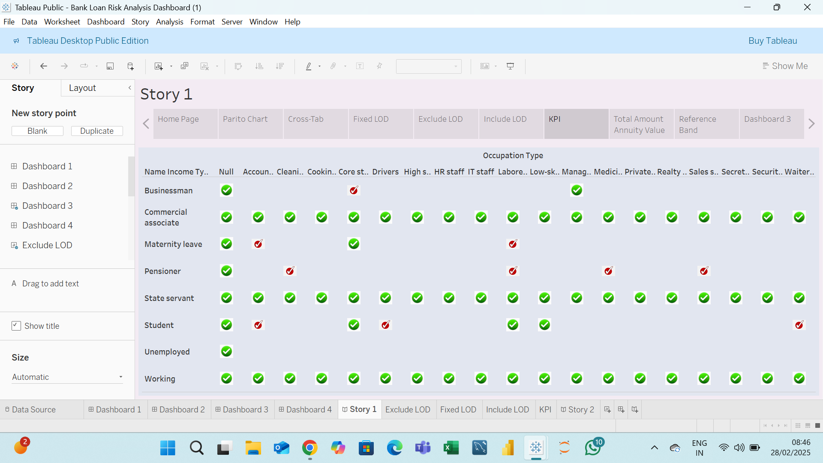
KPI Of Story 1

Slide 14

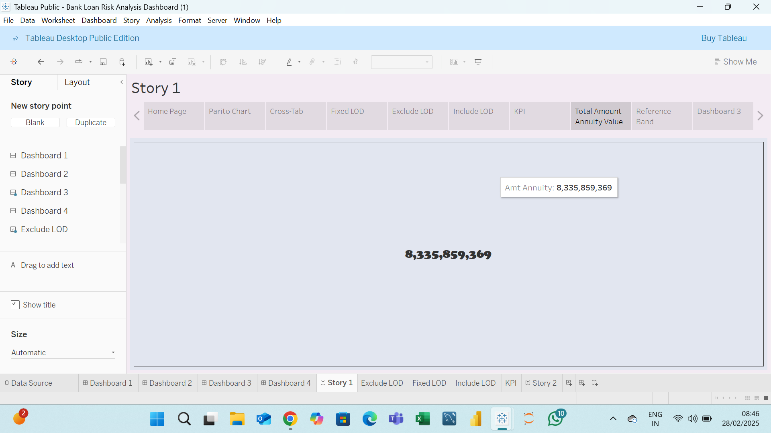
Total Amount Annuity Value Of Story1

Slide 15

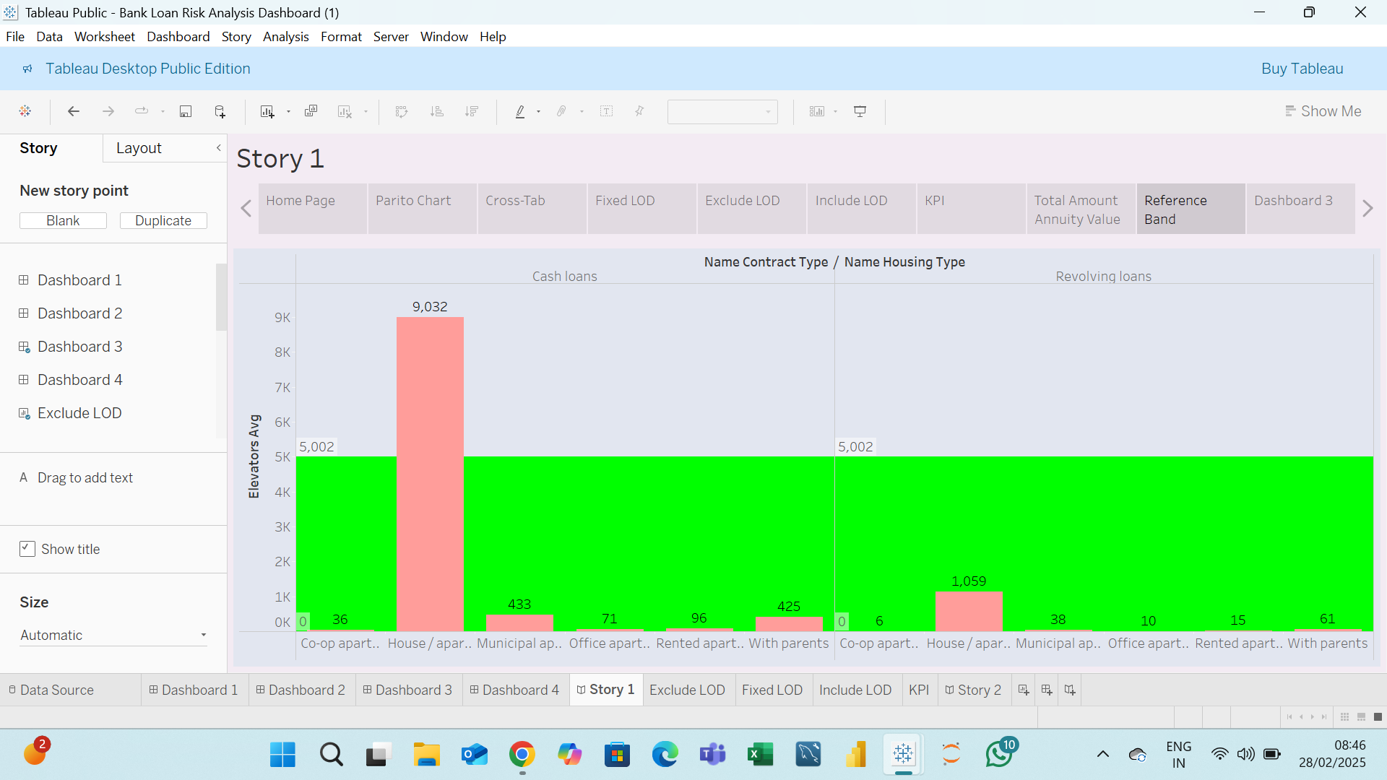
Reference Band Of Story 1

Slide 16

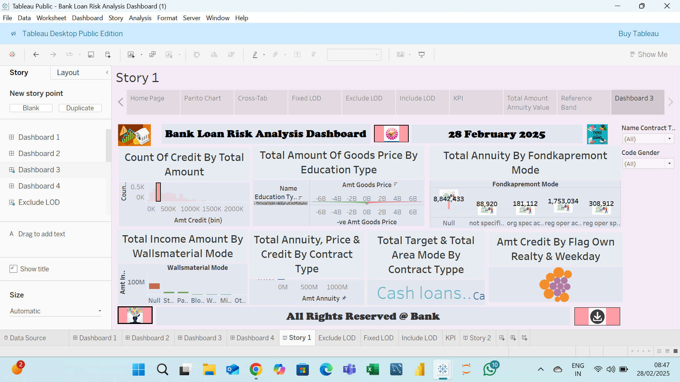
Dashboard 3 Of Story 1

Slide 17

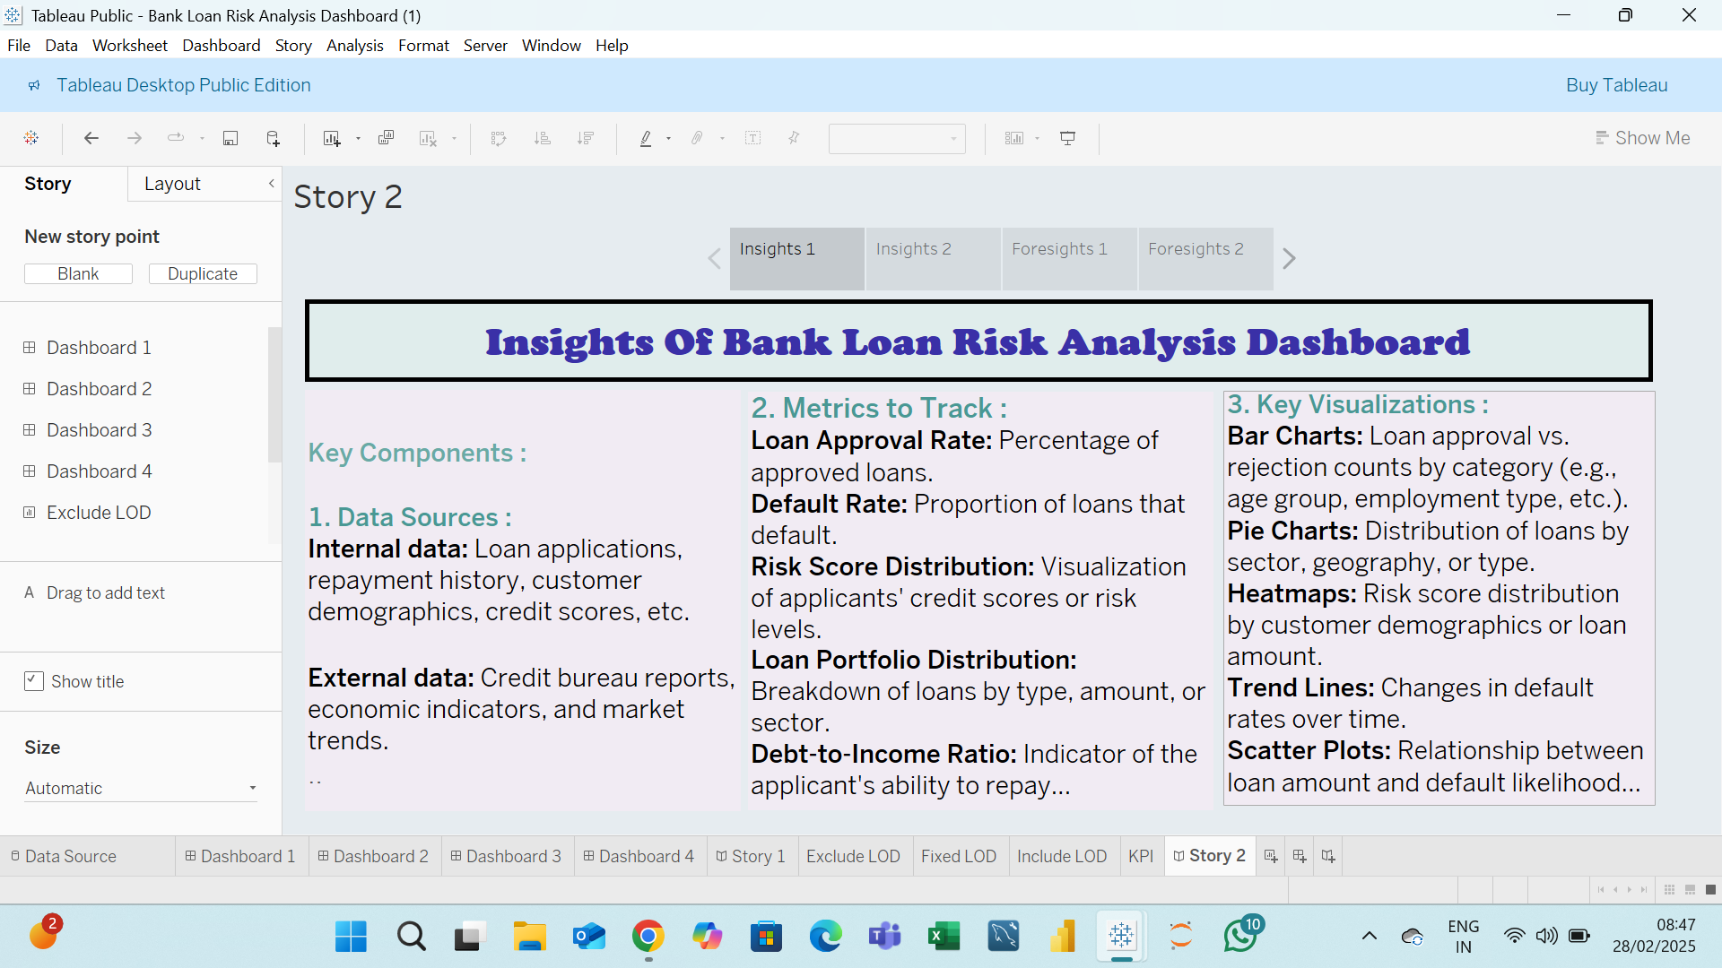
Insights 1 Of Story 2

Slide 18

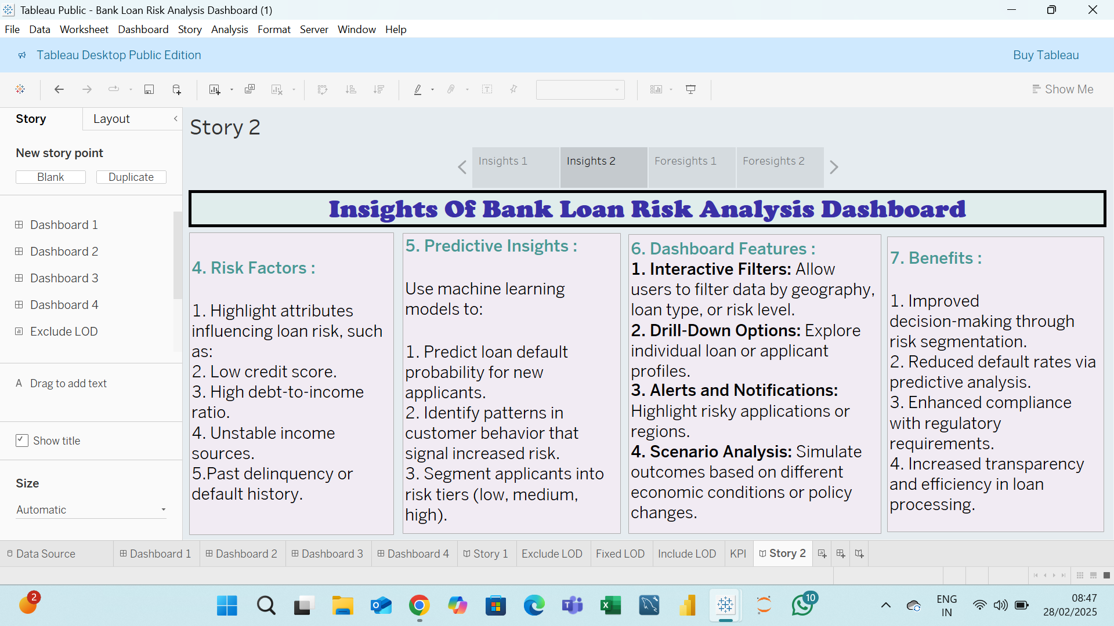
Insights 2 Of Story 2

Slide 19

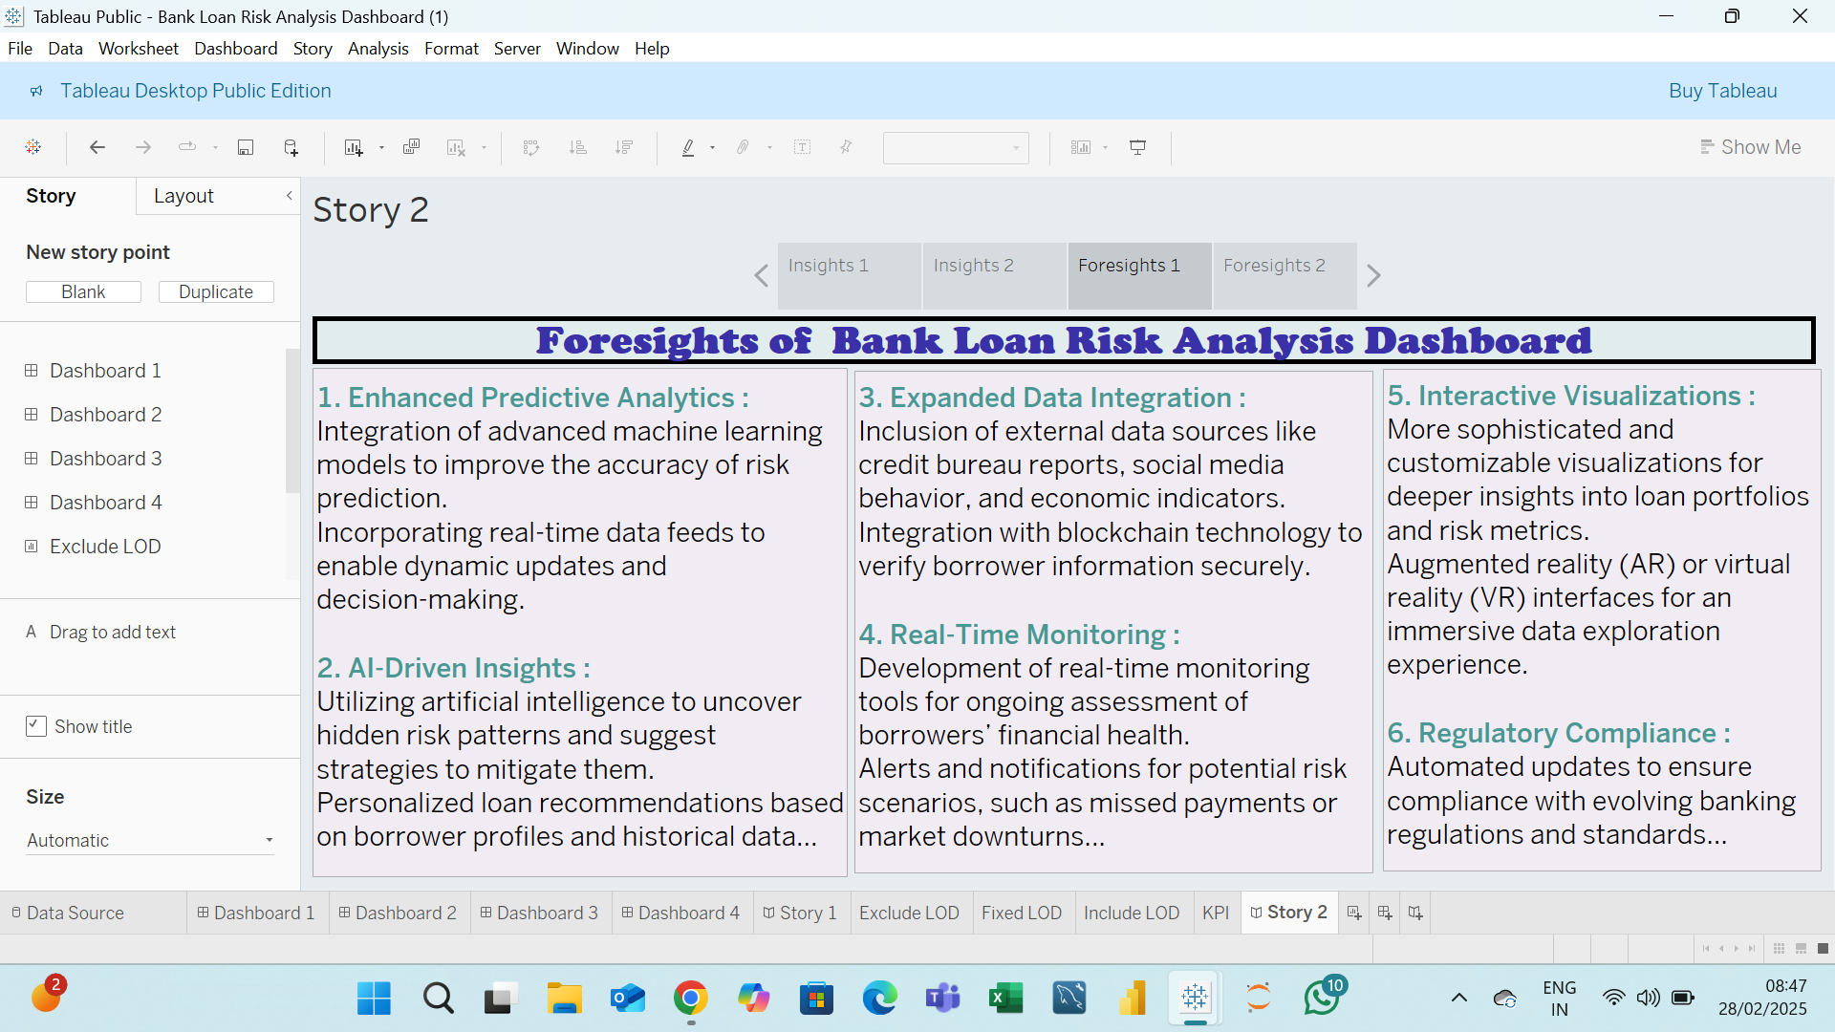
Foresights 1 Of Story 2

Slide 20

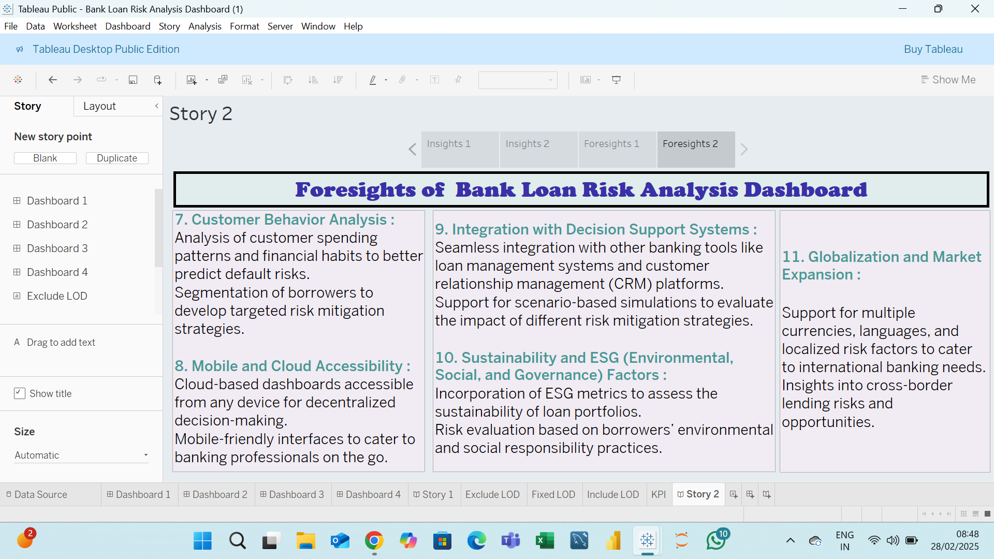
Foresight 2 Of Story 2

Slide 21


